Slide 1
Salem Press Online
Digital Resources for
Literature, History, Science,
Health & Careers
https://online.salempress.com

Slide 2
Salem Press Online
Provides immediate online access to research materials.
Titles are arranged under five broad subject categories: Literature, History, Science, Health, and Careers.
Log on to the library’s website, pick the Research Tools tab and look for Salem Press in the right column to get started

Slide 3
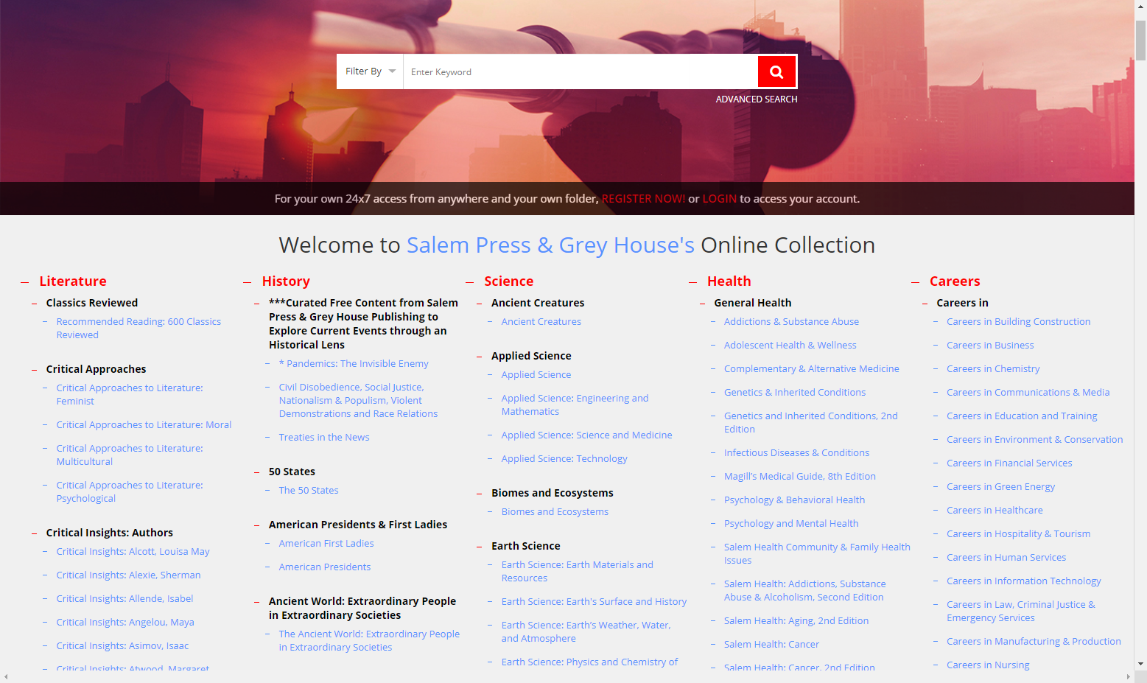

Slide 4

If you know what you’re searching for, enter your keyword and click the magnifying glass to start a search
If you’re searching for a phrase, add quotes before and after
You can also select any linked resource title to search in that specific book.

Slide 5
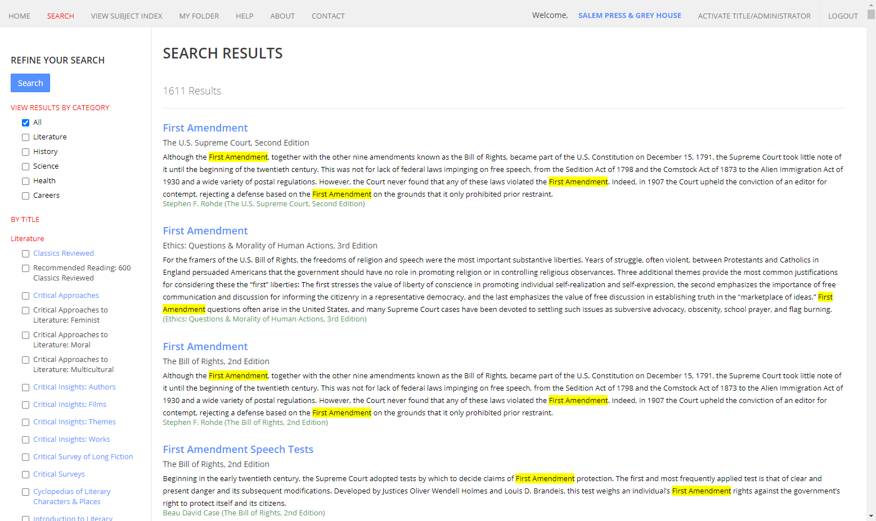
Your search terms are highlighted to spot them easily
Click on an article to open the full text

Slide 6
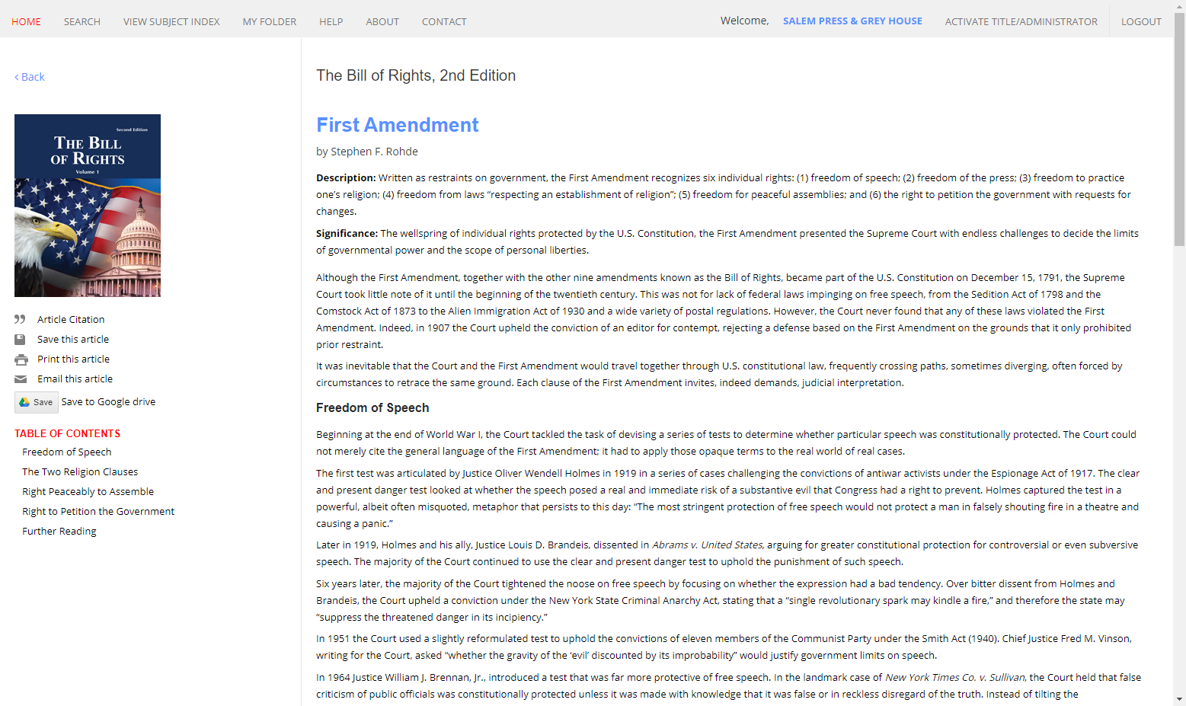
Click on a section in the table of contents to jump to that section

Slide 7
You can save an article into your personal account, email and print, plus save it to your google drive

Slide 8
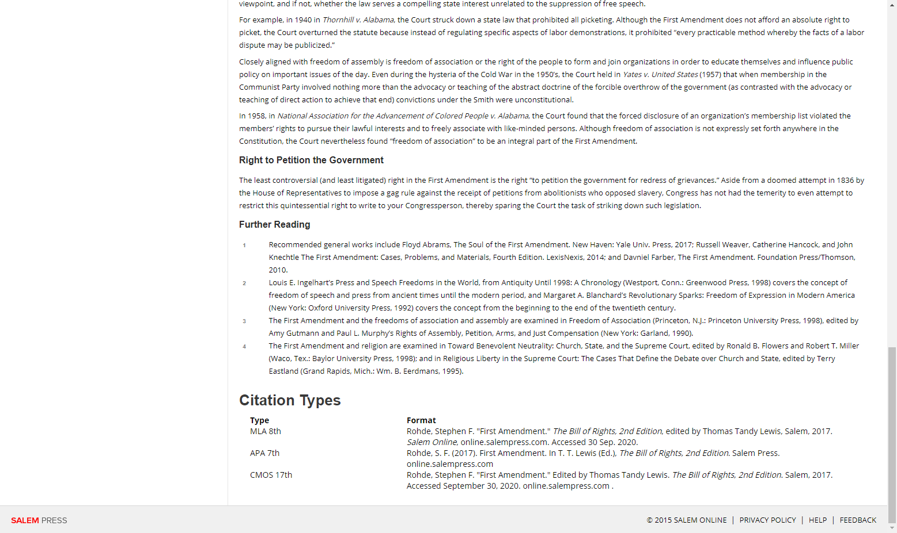
All articles display three types of citations

Slide 9
If you’re not sure what to search for, you can click on a book title to browse contents

Slide 10
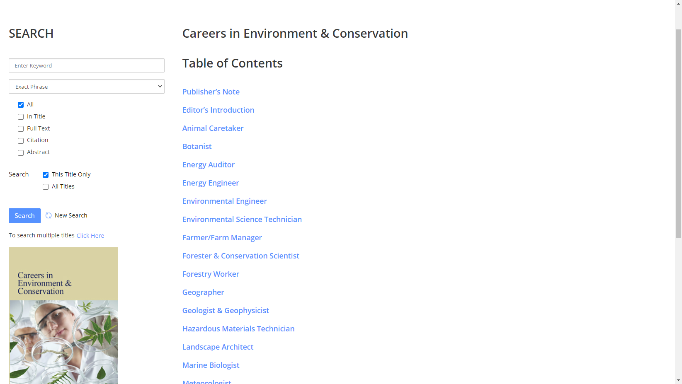
Click on an article to read further

Slide 11
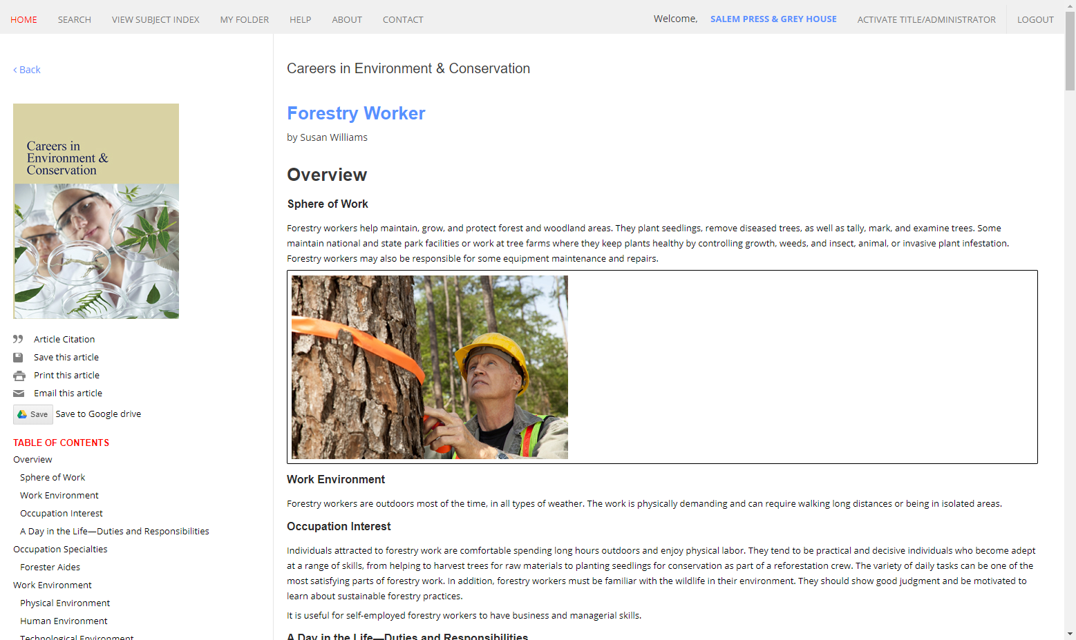
If you want to save an article to your personal account, click Save this article, then you can register to create an account

Slide 12
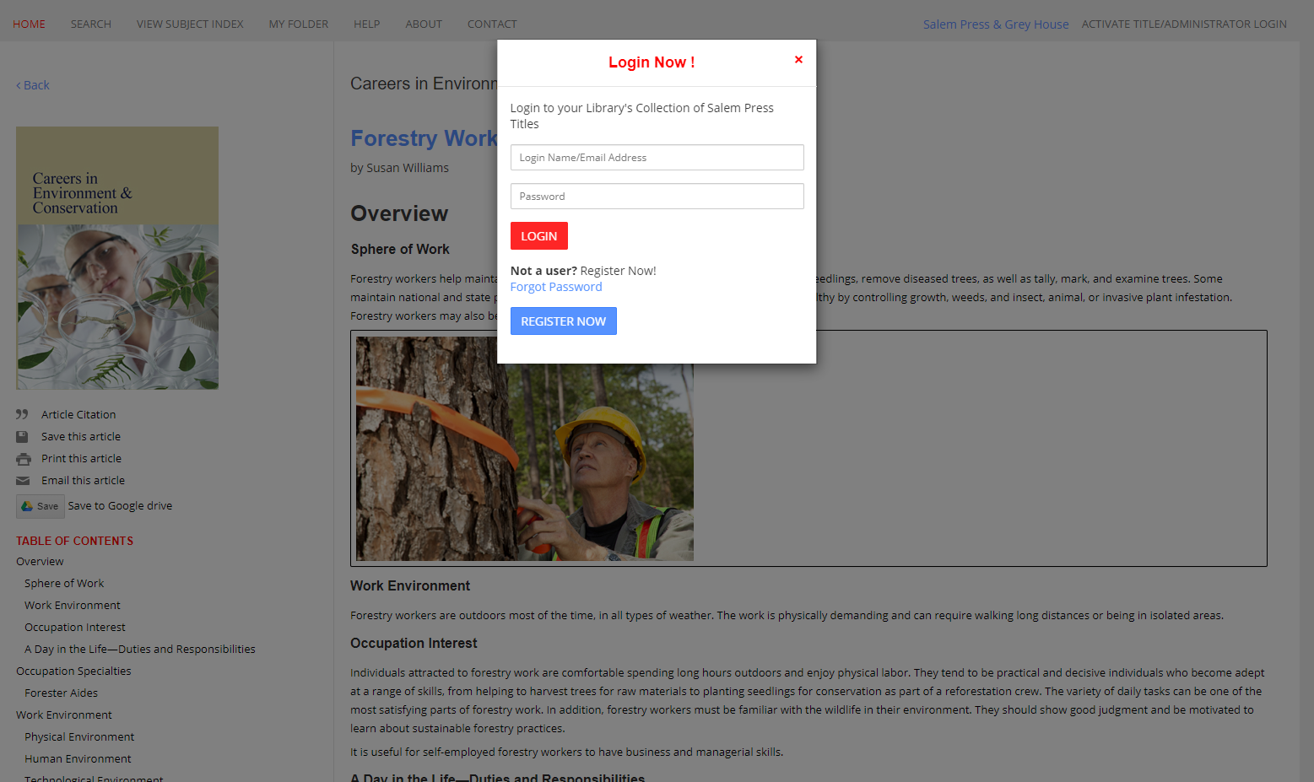
When you register for a personal account, you can save articles for later, take notes and save citations

Slide 13
Click on My Folder to access articles that you have saved

Slide 14
Need Help?
Please contact a Mrs. Hamel in the Library if you need help.

